Slide 1
INF 240 - Web Design
HTML5 and CSS3
<!doctype html>

Slide 2
HTML 5 and CSS 3 to the rescue?
HTML 5
Specifically designed for web applications on all platforms
HTML 5 will update HTML 4.01
CSS level 3
Will make it easier to do complex designs
Will look the same across all browsers, including mobile
CSS 3 will update CSS 2.1

Slide 3
Headlines
HTML 5 and CSS 3 bring many great features as well as fixing problems with the existing implementations
HTML 5 introduces new semantic tags and powerful APIs (aka JavaScript interfaces) for web applications
CSS 3 will make it easier to achieve real world designs and layouts with sophisticated typography

Slide 4
Which browsers support HTML5 and CSS3?
http://www.html5test.com/
http://www.findmebyip.com/litmus/

Slide 5
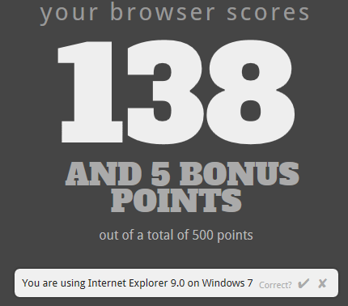
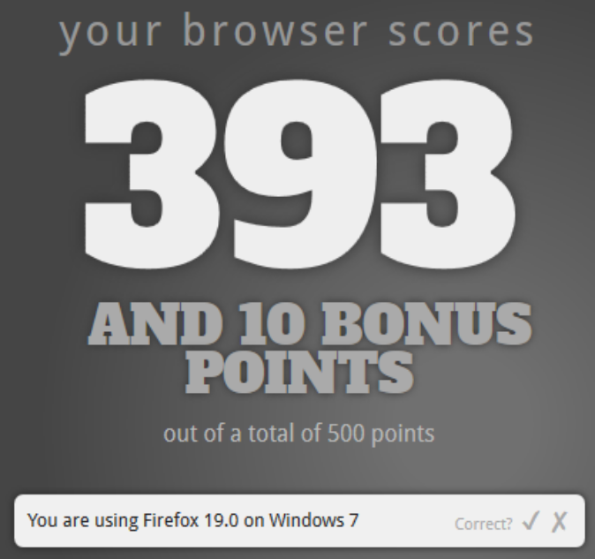
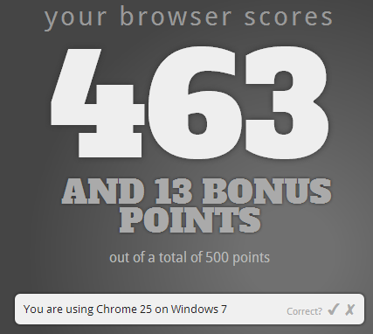

Slide 6
HTML5 Overview

Slide 7
HTML5?
HTML5 – the newest revision of HTML
  - Currently under development
  - Being developed by the HTML5 working group of the World Wide Web Consortium (W3C) since 2007!
  Parts of HTML5 have already been implemented in some browsers before the whole specification is ready
  W3C say target date for release is 2014.
  Most, if not all, features already installed in browsers.

Slide 8
One goal for HTML5
- make obsolete plugin-based rich Internet application (RIA) technologies such as Adobe Flash, Microsoft Silverlight, and Sun JavaFX.
http://www.infoworld.com/d/application-development/html5-could-it-kill-flash-and-silverlight-291
http://venturebeat.com/2010/06/04/apple-posts-demos-of-how-html5-can-beat-flash/
http://www.readwriteweb.com/start/2010/01/death-to-flash-3-great-html-5.php

Slide 9
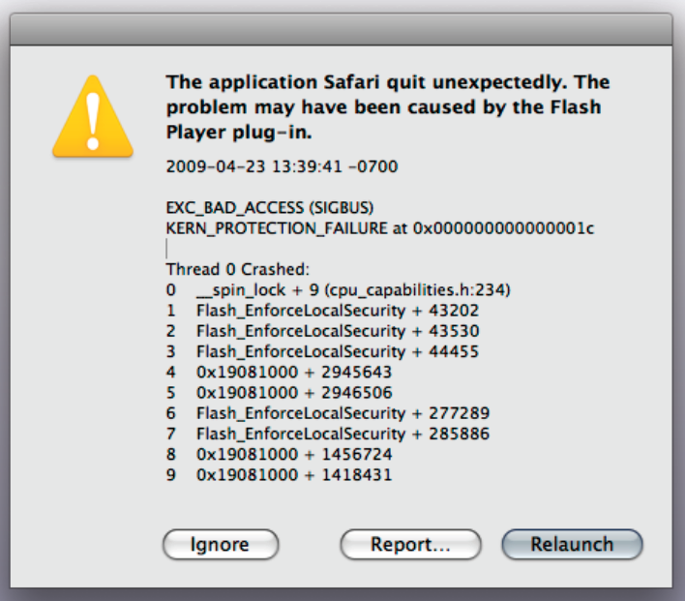
Solving problems like this ...

Slide 10
HTML5 Goals
Aimed to have all of the power of native applications.
Run on any platform (Windows, Linux, iPhone, Android, etc.)
New features should be based on HTML, CSS and JavaScript.
Reduce the need for external plugins.
Better error handling.
More markup to replace scripting.

Slide 11
Modified Tags
Doctype tag:
HTML tag:
Meta tag:
Script tag:
<!doctype html>
<html lang="en">
<meta charset="utf-8">
<script language="javascript">

Slide 12
HTML5 markup template
<!doctype html>
<html lang="en">
<head>
<title>Web page title</title>
<meta charset="utf-8" >
</head>
<body>
Web page content
</body>
</html>

Slide 13
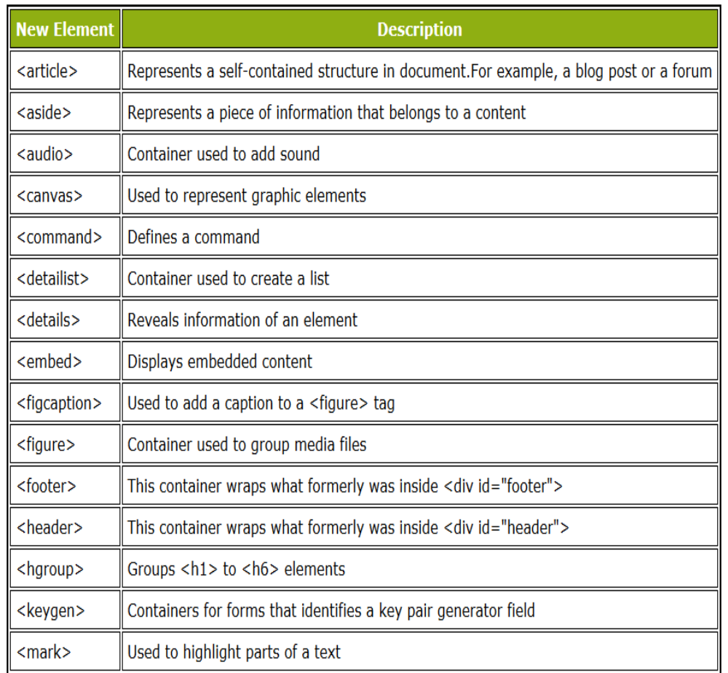
HTML5 brings 28 new elements to help improve the design of your website.

Slide 14
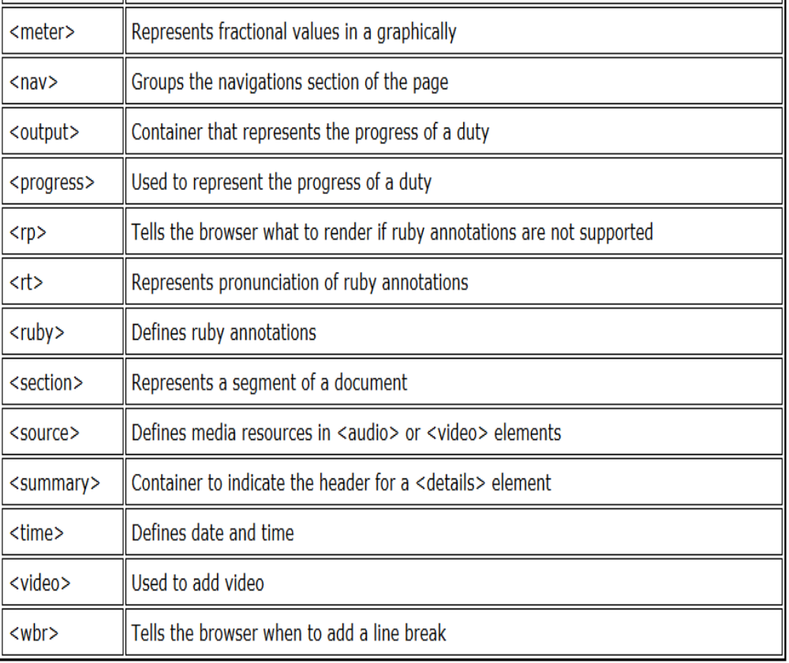

Slide 15
New Tags for Page Layout
Today, if we wanted to markup a layout for a web page, we would use a lot of <div> tags to specify the different sections of the page.
HTML5 introduces a set of new tags specifically for layout.

Slide 16
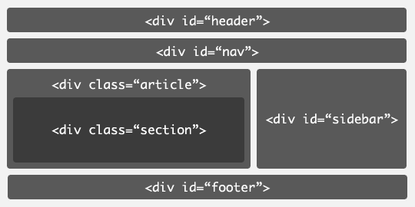
Current Layout Structure with <div> Tags

Slide 17
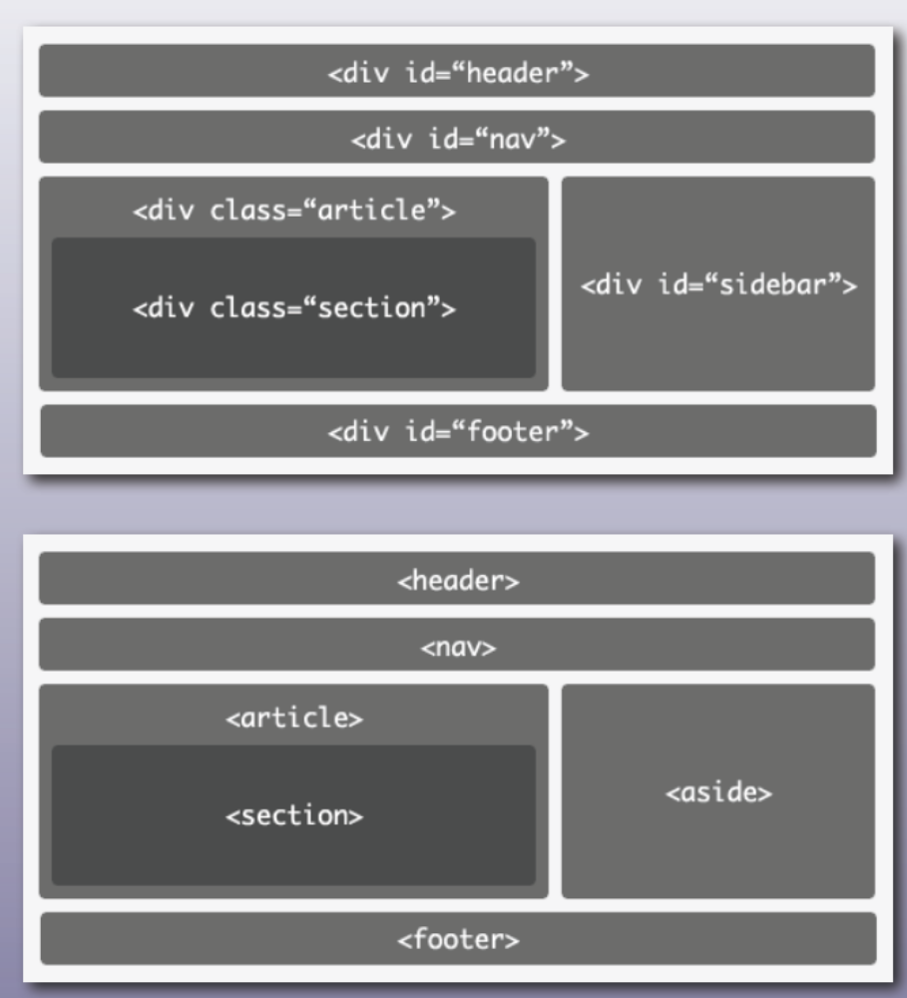

Slide 18
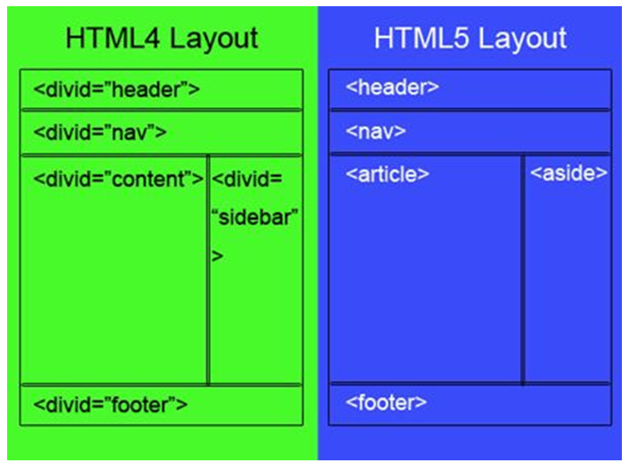

Slide 19
New Layout Structure
Better layout structure → new structural elements
  <section>
  <header>
  <nav>
  <article>
  <aside>
  <footer>
  …

Slide 20
New Layout Structure
Elements like <header> and <footer> are not meant to be only at the top and bottom of the page.
<header> and <footer> may be for each document section
  Not very different from <div> tag, but are more semantically well-defined in the document structure

Slide 21
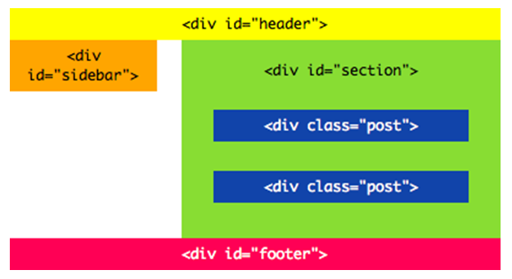
Current

Slide 22
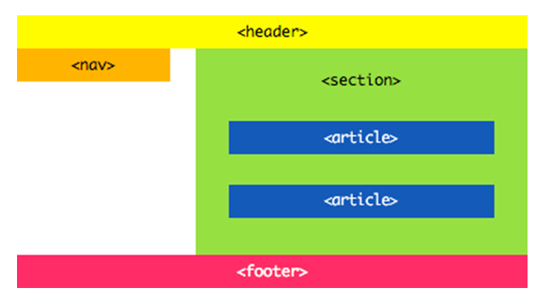
HTML5

Slide 23
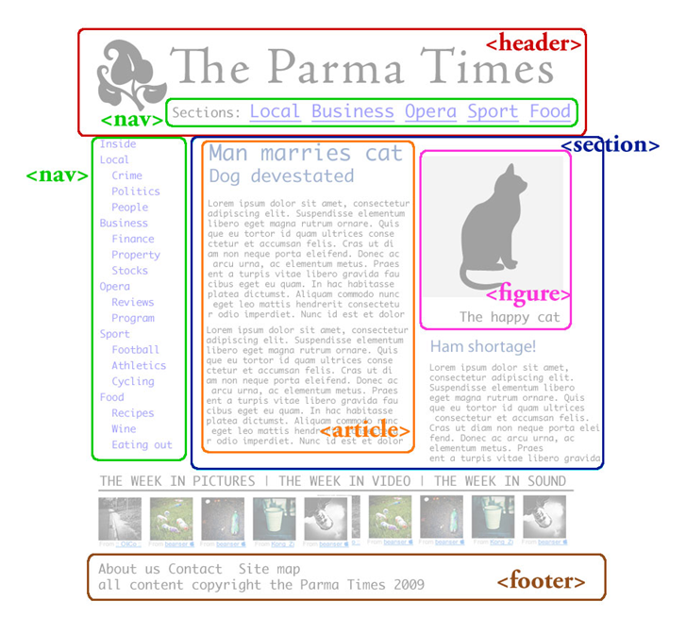
Example

Slide 24
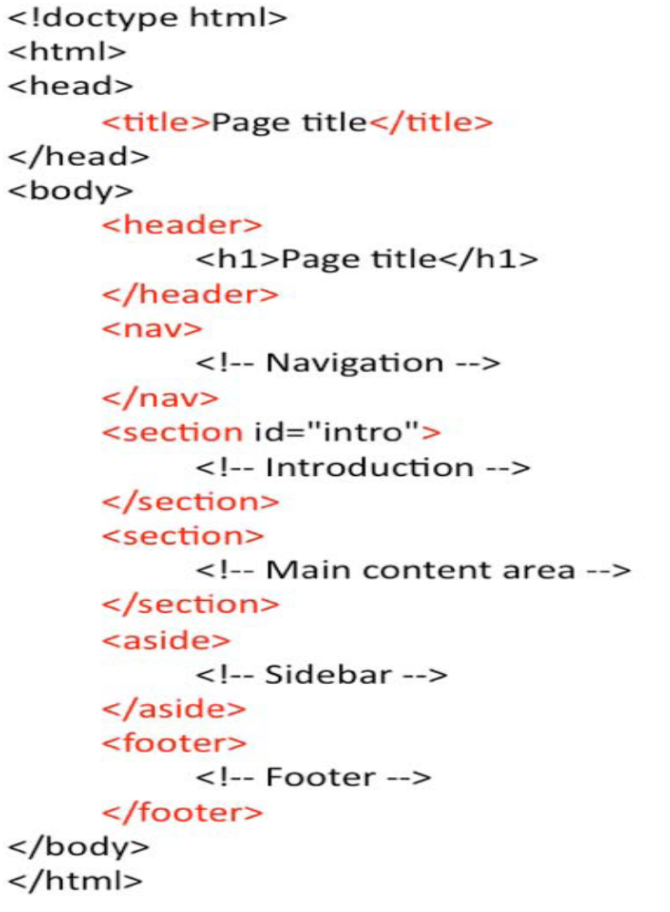

Slide 25
New Tags
<article>
  For external content, like text from a news-article, blog, forum, or any other external source
<aside>
  For content aside from (but related to) the content it is placed in
<details>
  For describing details about a document, or parts of a document
<summary>
  A caption, or summary, inside the <details> element

Slide 26
New Tags
<mark>
  For text that should be highlighted
<nav>
  For a section of navigation
<section>
  For a section in a document (e.g. chapters, headers, footers)
<wbr>
  Word break. For defining an appropriate place to break a long word or sentence
Other tags
  <command>, <datalist>, <details>, <progress>, etc.

Slide 27
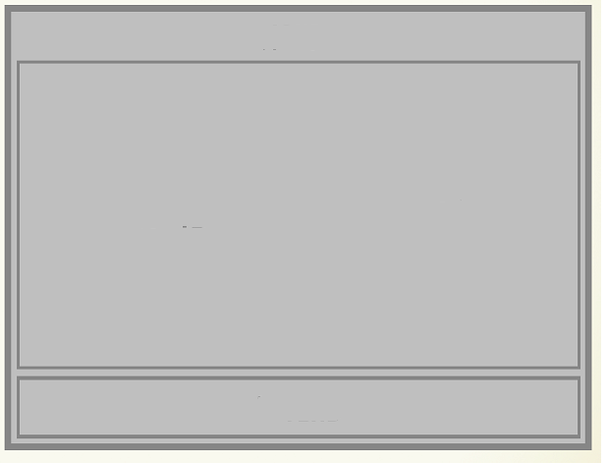
figure Element
Allows for associating captions with embedded content, including images, audio or videos.
<figure>
Image, audio, video, etc.
<figcaption>

Slide 28

Posted 9 April 2012
<time>
Some image
<figure>
<meter>
<figcaption>
Some caption text

Slide 29
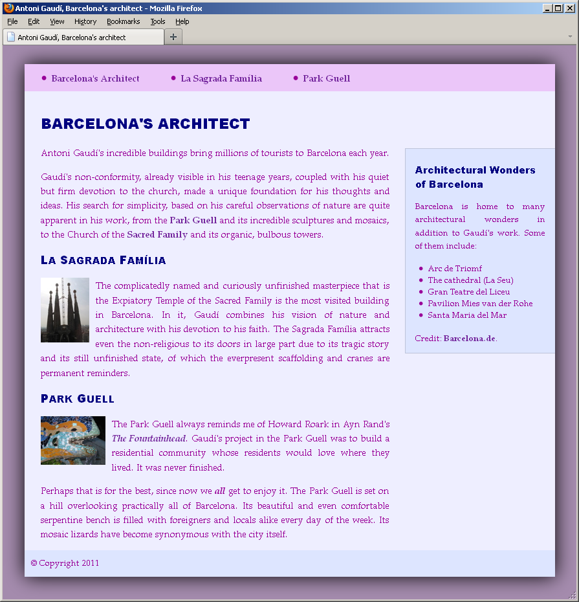
Example: four main components of a web page:
  Masthead with navigation
  Article in main content area
  Sidebar with tangential
  information
  Footer

Slide 30
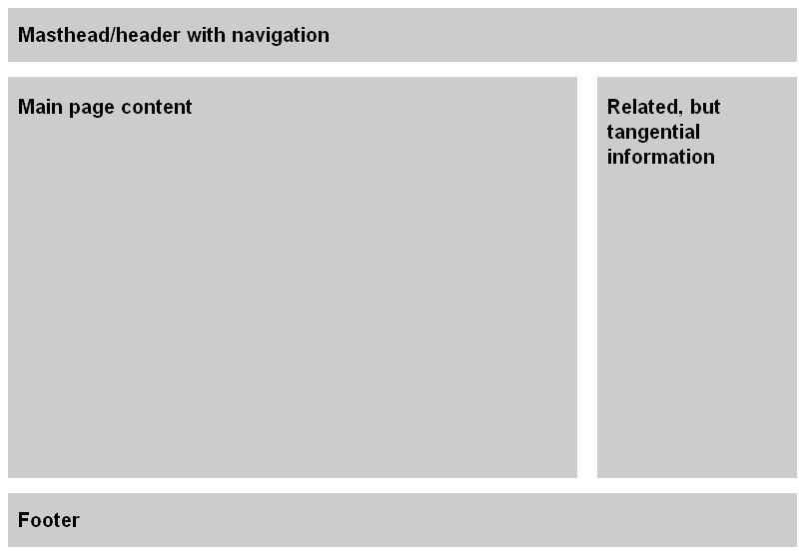
Use header, nav, article, section, aside, footer, and div elements to define structure of pages.
  Except div, none of these elements existed prior to HTML5.

Slide 31
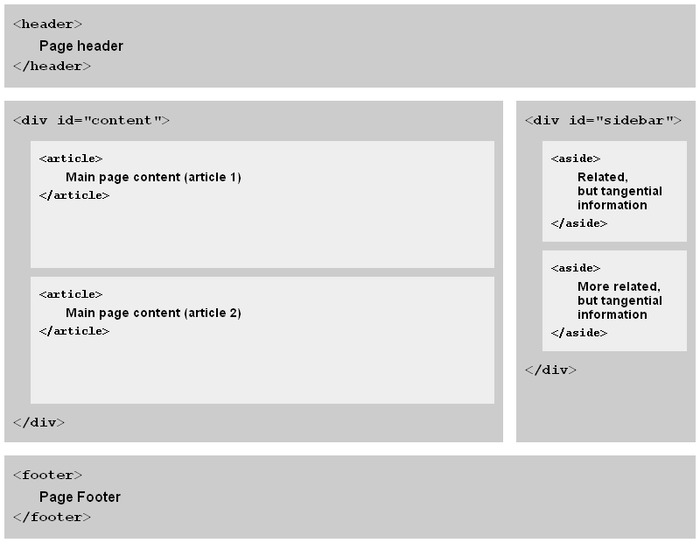
Another format: still use divs as containers

Slide 32
Example
<body>
<header>
<nav>
<ul>
<li><a href="#gaudi">Barcelona's Architect</a></li>
<li ><a href="#sagrada-familia">La Sagrada Familia</a></li>
<li><a href="#park-guell">ParkGuell</a></li>
</ul>
</nav>
</header>
</body>
</html>

Slide 33
Example
http://html5advent.com/

Slide 34
Multimedia
Currently video and audio in a Web page is best handled by plugins (Flash, Silverlight, QuickTime, etc.)
New <video> and <audio> tags will be used as the <img> tag is today.
Web pages will need to define how video and audio should be played (controls, interface, etc.)

Slide 35
New Multimedia Tags
Media Tags
  <audio>
    Attributes: autoplay, controls, loop, src
  <video>
    Attributes: autoplay, controls, loop, height, width, src
    The <source> element is used when you want to upload multiple audio or video elements.

Slide 36
Basic HTML5 markup for audio/video
<video src=”movie.mp4” controls />
<audio src=”track.mp3” controls />

Slide 37
<audio width="360" height="240" controls= "controls" >
<source src="someSong.mp3" type="audio/mp3">
<source src="someSong.ogg" type="audio/ogg">
</source>
Audio tag is not supported
</audio>
Note: May also write
<audio width="360" height="240" controls >
<source src="someSong.mp3" type="audio/mp3">
</source>
Audio tag is not supported
</audio>

Slide 38
video attributes
width – sets the width of the video element in pixels. If the width is omitted, the browser will use the default width of the video, if it’s available.
height – sets the height of the video element. If the height is omitted, the browser will use the default height of the video, if it’s available.
src – sets the video file to be played. For reach, you should supply video formats that are supported by the most popular browsers.
poster – sets the image file that will be displayed while the video content is being loaded, or until the user plays the video. If a poster file is omitted, the browser will show the first frame of the video.

Slide 39
autoplay – instructs the browser to automatically play the video when the page is loaded.
controls – displays the video controls to control the video playback. The controls are visible when the user hovers over a video. It’s also possible to tab through the controls.
loop – instructs the browser to loop the media playback.
autobuffer – used when autoplay is not used. The video is downloaded in the background, so when the user does decide to watch the video, it starts immediately.

Slide 40
<video width="320"
src="intro.mp4"
height="240"
poster="intro.jpg"
autoplay
controls
loop>
This content appears if the video tag or the codec is not supported.
</video>

Slide 41
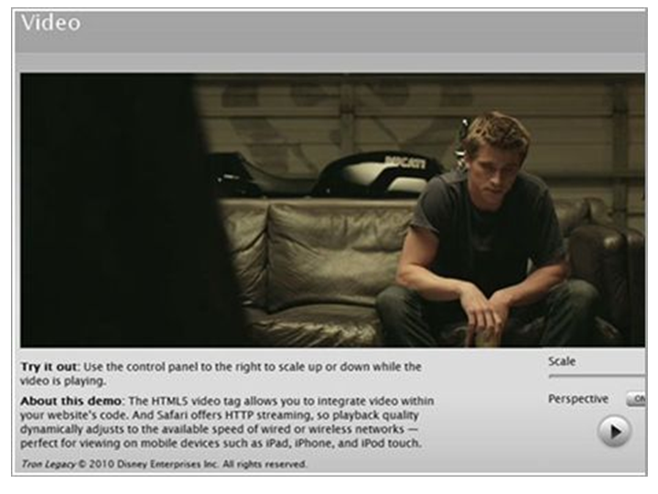
video Example
https://developer.apple.com/safaridemos/showcase/video/
http://disneydigitalbooks.go.com/tron/#

Slide 42
Example
http://htmlfive.appspot.com/static/video.html

Slide 43
The audio element
<audio src="elvis.mp3"
preload="auto"
controls
autoplay
loop
muted>
This content appears if the audio tag or the codec is not supported.
</audio>

Slide 44
audio attributes
src – specifies the audio file to be played. For reach, you should supply audio formats that are supported by the most popular browsers
preload – none / metadata / auto – where metadata means preload just the metadata and auto leaves the browser to decide whether to preload the whole file
controls – displays the audio controls
autoplay – instructs the browser to automatically play the audio when the page is loaded

Slide 45
loop – instructs the browser to loop the media playback.
muted – sets the default audio output.

Slide 46
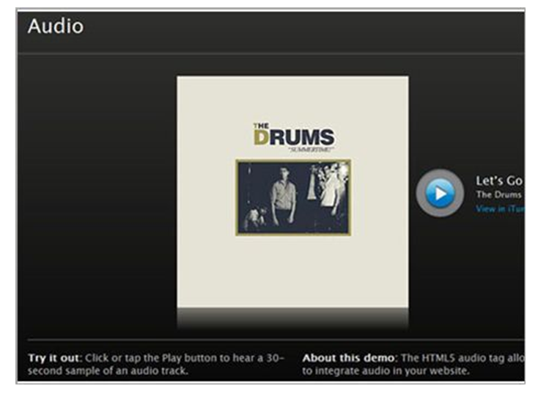
audio Example
http://www.apple.com/html5/

Slide 47
Some reading …
http://www.sitepoint.com/using-html5-video-and-audio-in-modern-browsers/#fbid=dtjjquWRD-x
http://blogs.msdn.com/b/ie/archive/2011/05/13/unlocking-the-power-of-html5-lt-audio-gt.aspx
http://blogs.msdn.com/b/nigel/archive/2011/04/14/5-things-you-need-to-know-to-start-using-video-and-audio-today.aspx?ocid=soc-n-nz-loc--nptweet

Slide 48
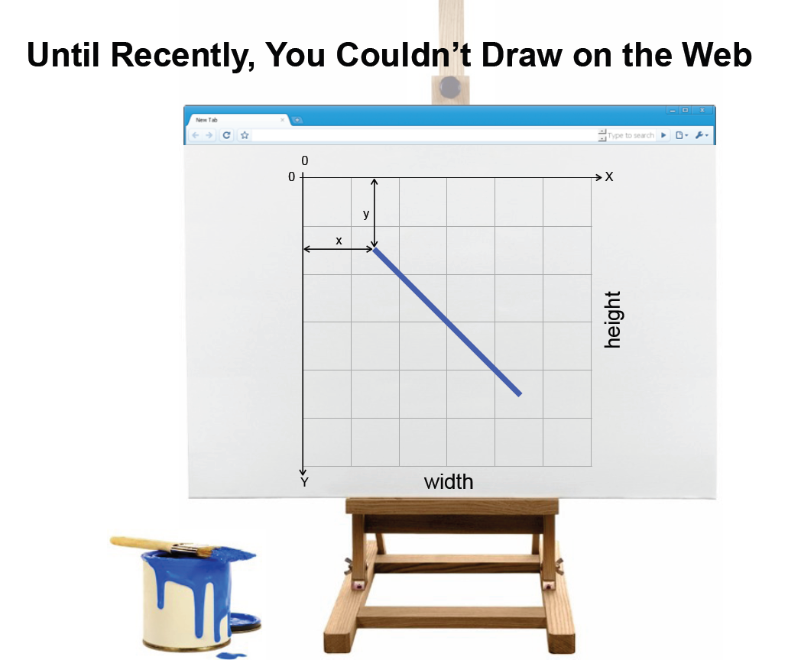
canvas

Slide 49
The <canvas> element has several methods for drawing paths, boxes, circles, characters and adding images.
It consists of a drawable region (aka canvas) defined in HTML code with height and width attributes.
- Then, JavaScript code may access the area through a full set of drawing functions similar to those of other common 2D APIs.
Thus, the HTML5 canvas element allows for dynamically generated graphics, drawing on a web page, and interaction, such as zooming in/out.
Some anticipated uses of canvas include building graphs, animations, games, and image composition.

Slide 50
canvas Element
Uses JavaScript to draw graphics on a web page
A rectangular area, you control every pixel of it
It has several methods for drawing paths, boxes, circles, characters, and adding images
Create a canvas element:
•Add a canvas element to the HTML5 page.
•Specify the id, width, and height of the element
<canvas id="myCanvas" width="200" height="100">
</canvas>

Slide 51

<canvas id=“myCanvas" height="200" width="200">
Your browser does not support HTML5 canvas.
</canvas>
<script language="javascript">
var example = document.getElementById(“myCanvas");
var context = example.getContext("2d");
context.fillStyle = "rgb(255,0,0)";
context.fillRect(30, 30, 50, 50);
</script>

Slide 52
Canvas Element
Draw with JavaScript.
<script language="javascript">
var c=document.getElementById(“myCanvas");
var cxt=c.getContext("2d");
cxt.fillStyle="#00FF00";
cxt.fillRect(0,0,150,75);
</script>
Draws a green rectangle.

Slide 53
Example
Draw a line by specifying where to start, and where to stop
<script language="javascript">
var c=document.getElementById(“myCanvas");
var cxt=c.getContext("2d");
cxt.moveTo(10,10);
cxt.lineTo(150,50);
cxt.lineTo(10,50);
cxt.stroke();
</script>

Slide 54
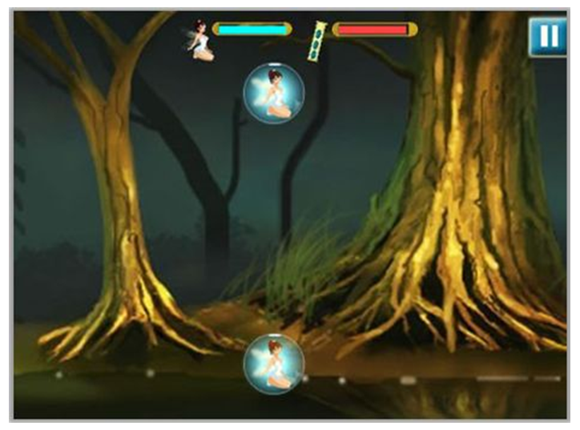
The above screenshot is an HTML5 canvas game.

Slide 55
Aside: SVG – Scalable Vector Graphics
A W3C recommendation for vector-based graphics for the Web – an alternative for canvas – the svg element
SVG defines the graphics in XML format
SVG graphics do not lose any quality if they are zoomed or resized
Every element and every attribute in SVG files can be animated

Slide 56

Example
<html>
<body>
<svg xmlns=http://www.w3.org/2000/svg
version="1.1">
<circle cx="100" cy="50" r="40" stroke="black"
stroke-width="2" fill="red"/>
</svg>
</body>
</html>

Slide 57
Video about SVG
http://www.youtube.com/watch?v=XCk22AaRxiE&eurl=http%3A%2F%2Fwww%2Egmodules%2Ecom%2Fgadgets%2Fifr%3Furl%3Dhttp%253A%252F%252Fgoogle%2Dcode%2Dproject%2Dhosting%2Dgadgets%2Egooglecode%2Ecom%252Fsvn%252Fbuild%252Fprod%252Fv&feature=player_embedded
Google video on HTML5 (41 minutes!)
http://www.youtube.com/watch?v=siOHh0uzcuY

Slide 58
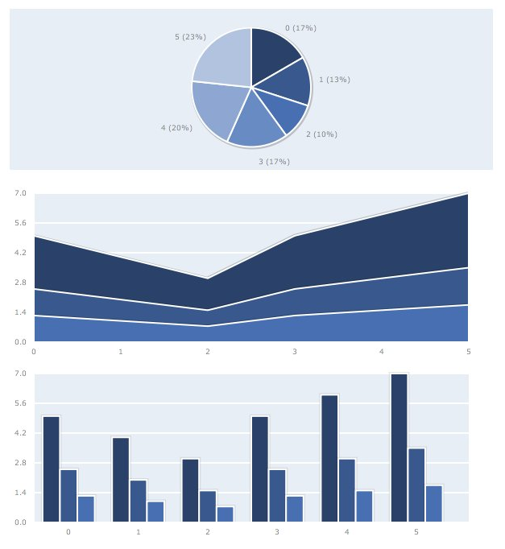
Canvas Examples: Graphs with Plotkit
http://www.liquidx.net/plotkit/

Slide 59

Clone of MS Paint built with Canvas
http://canvashop.googlecode.com/svn/trunk/src/CanvaShop.html
A web application by Google.

Slide 60
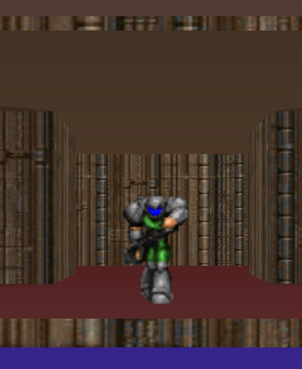
Experimental First-Person Shooter Game - 3D Graphics
- Canvex
http://canvex.lazyilluminati.com/

Slide 61
2-D Game
http://htmlfive.appspot.com/static/gifter.html
http://www.benjoffe.com/code/demos/canvascape/textures

Slide 62
HTML5 Demos
http://html5demos.com/
HTML5 Online Presentation
http://slides.html5rocks.com/#slide1

Slide 63
HTML5 Reading
http://www.informit.com/articles/article.aspx?p=1659407
http://www.informit.com/articles/article.aspx?p=1659408

Slide 64
CSS3 Overview

Slide 65
Many new properties introduced in CSS3
- Number has nearly doubled!
No announcement has yet been made by W3C for a release date
CSS3 is further behind in development compared to HTML5
But browser developers have introduced many CSS3
Properties into their browsers.

Slide 66
CSS3 Modules
CSS3 is split up into "modules".
Some of the most important CSS3 modules are
Selectors
Box Model
Backgrounds and Borders
Text Effects
2D/3D Transformations
Animations
Multiple Column Layout
User Interface

Slide 67
CSS3 is still under active development, and although W3C has defined draft syntax standards, browser developers have started a CSS3 “war” – developing their own syntax for some new CSS3 keywords!
In the not-so-distant past, had to specify a range of
keywords for different browsers in your web page!
E.g.
W3C: border-radius
Safari and Chrome: -webkit-border-radius
Firefox: -moz-border-radius
Internet Explorer: -ms-radius
Opera: -o-radius

Slide 68
  To use, place prefix before CSS property name.
  In most cases, only need -moz- and -webkit- prefixes.
  Recommended: To future-proof work, include non-prefixed version as last declaration.
Eventually, all browsers will move to W3C standards.
I tried just the W3C keyword for several properties,
and they worked fine.

Slide 69
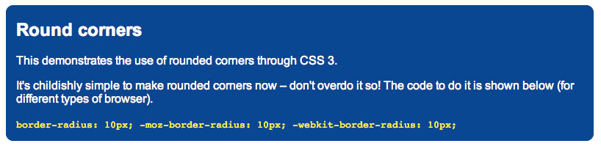
CSS-3 overview: round corners
border-radius (or variant depending on browser) is used to make rounded corners
Example:
border-radius: 3px
The bigger the value or the radius, the more curvy and larger are the rounded corners
Much simpler than using CSS 2 (no background images etc. needed)

Slide 70
Example
#box { background-color: #74C0FF;
margin-left: 60px;
padding: 5px 10px;
border: 1px solid #000000;
-webkit-border-radius: 15px;
-moz-border-radius: 15px;
border-radius: 15px;
}

Slide 71
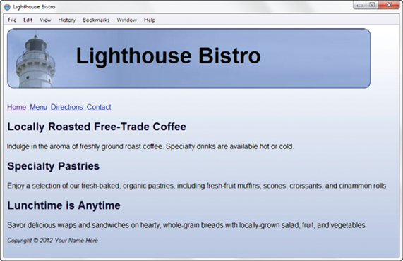
h1 { border: 1px solid #000033;
-webkit-border-radius: 15px;
-moz-border-radius: 15px;
border-radius: 15px;
}

Slide 72
Syntax
border-radius: 1-4 lengths;
Note: The four values for each radii are given in the order top-left, top-right, bottom-right, bottom-left.
If bottom-left is omitted it is the same as top-right.
If bottom-right is omitted it is the same as top-left.
If top-right is omitted it is the same as top-left.

Slide 73


Rounded Corners Rendered with Border-Radius Support

Slide 74
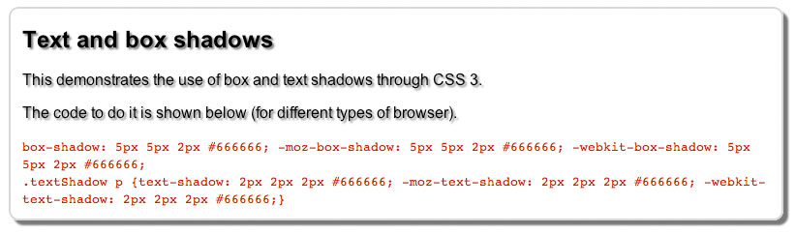
CSS-3 overview: box- and text-shadow
box-shadow creates a drop shadow effect (3 lengths and a colour)
Example:
box-shadow: 10px 6px 5px #888;
10px is horizontal offset, 6px is vertical offset, 5px is ‘blur radius’
To put the shadow on the left and top, use negative values for the first two offsets
Higher blur radius = more blurred
text-shadow is similar but applied to text

Slide 75
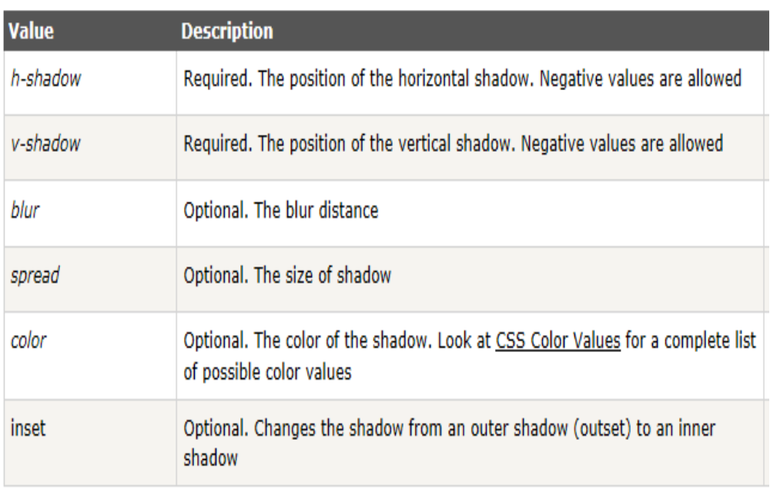
Syntax
box-shadow: h-shadow v-shadow blur spread color inset;

Slide 76
Example
#container { margin: auto;
background-color: #ffffff;
width: 800px;
padding: 20px;
-webkit-box-shadow: 5px 5px 5px #1e1e1e;
-moz-box-shadow: 5px 5px 5px #1e1e1e;
box-shadow: 5px 5px 5px #1e1e1e;
}
#wrapper { -webkit-box-shadow: 5px 5px 5px #828282;
-moz-box-shadow: 5px 5px 5px #828282;
box-shadow: 5px 5px 5px #828282;
}

Slide 77
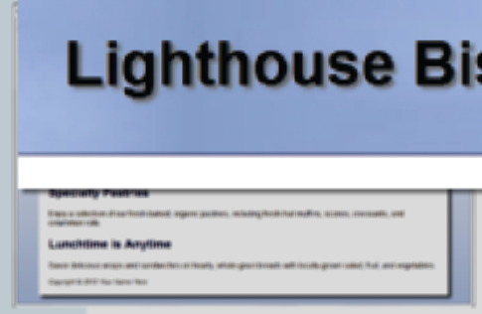
#wrapper { text-shadow: 3px 3px 3px #666;
}

Slide 78
CSS-3 overview: opacity
Configure the opacity of the background colour
Opacity range:
0 - Completely Transparent
1 - Completely Opaque
Example:
h1{ background-color: #FFFFFF;
opacity: 0.6; }

Slide 79
CSS3 Gradients
Gradient: a smooth blending of shades from one color to another
Use the background-image property
  linear-gradient()
  radial-gradient()
Example:
background-color: #8FA5CE;
background-image: -webkit-gradient(linear, left top, left bottom, from(#FFFFFF), to(#8FA5CE));
background-image: -moz-linear-gradient(top, #FFFFFF, #8FA5CE);

Slide 80
Using Gradient Backgrounds
Gradient backgrounds: Creates transitions from one color to another without using images. New in CSS3.
Two primary styles of gradients: linear and radial.
Include fallback option for browsers that do not support background gradient property.
  Simple background color or image specified as separate rule prior to background gradient rule in CSS.
To create multicolor gradients: Specify more than two colors and use optional parameter in gradient syntax.

Slide 81
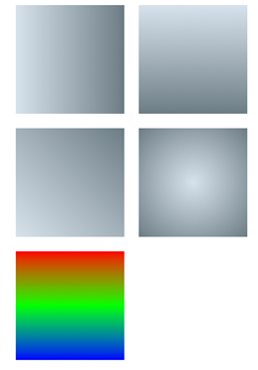
Also top, bottom right
.horizontal {
background: #cedce7;
background: linear gradient(left, #cedce7, #596a72);
}
.radial {
background: #cedce7;
background: radial-gradient(center, #cedce7,#596a72);
}

Slide 82
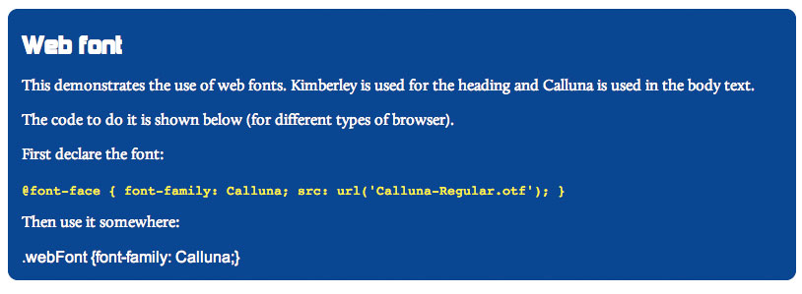
CSS-3 overview: @font-face
@font-face lets you use any licensed TrueType (.ttf) or OpenType (.otf) font on your page
First declare the font:
@font-face { font-family: Calluna; src: url('Calluna-Regular.otf');}
Then use it like a normal font:
.webFont {font-family: Calluna;}

Slide 83
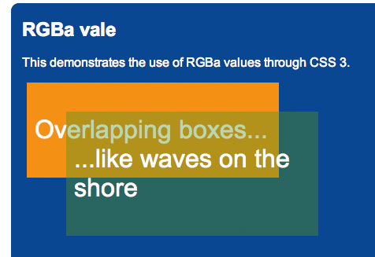
CSS-3 overview: rgba (alpha channel colour)
rgba lets you specify a normal RGB colour and a value for transparency (alpha channel)
Example:
background: rgba(255,0,0.1)
alpha value (last number) is a value between 0 (fully transparent) and 1 (fully opaque)
Big difference with CSS opacity property is that it is not inherited (just applied to background colour and not text)
Ultimately leads to simpler and easier to maintain code and more ‘creative’ possibilities

Slide 84
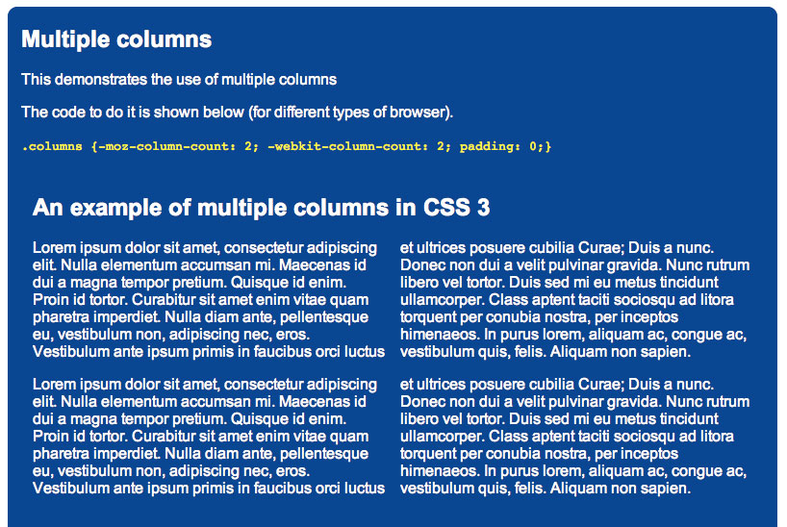
CSS-3 overview: Multi-column layout
Allows you to split text newspaper-like across multiple columns
Express in terms of number of columns or width.
Example 1:
column-width: 45%; column-gap 5%;
Example 2:
column-count: 3;

Slide 85
See Firefox examples at
http://vanseodesign.com/blog/demo/multi-column/
http://www.vanseodesign.com/css/multi-columns/

Slide 86

Questions?

